Slide 1
PHYSICAL EDUCATION AND STUDENTS WITH

Slide 2
Autism Spectrum Disorder (ASD)
1 out of every 45 children (CDC, 2014)
Fastest growing developmental disability in the U.S.
Boys are 5x more likely to be diagnosed with AU
No medical detection or cure
Difficulty in:
Sensory processing,
social interaction,
verbal and nonverbal communication
repetitive behaviors
Paradigm Shift
AWARENESS ACCEPTANCE
AU PSA

Slide 3
Sensory Processing Disorder (SPD)
Neurological process of organizing sensations for use in everyday life.
Done without conscious effort – automatic adaptive responses:
Climbing stairs – flex and extend legs, alternate feet, slide hand along banister, maintain balance, remain upright, look ahead
The Five Main Senses: vision, hearing, smell, taste, and touch
Additional (vital) Senses:
The tactile sense – provides information through surface of skin about the texture, shape, and size of objects within the environment.
The vestibular sense – provides information through the inner ear about gravity and space, balance and movement, and head/body position in relation to the surface of the earth.
The proprioceptive sense – provides information through muscles and joints about where our bodies are, how they’re moving/stretching, and what they’re doing.
MANY (maybe most) students on the AU spectrum have SPD.
The converse is not true – most students with SPD do not have autism.
SPD - Youtube

Slide 4
Communication
Put yourself in their shoes
Expressive vs. Receptive
Just because they cannot express things verbally, does not mean they do not understand.
Processing Time
Allow time for student(s) to process information
Every time instructions/cues are repeated, student(s) have to re-process
Body Language
Pay attention

Slide 6
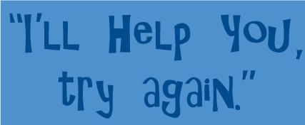
Communication Continued…
Verbal Behavior Approach (VBA)
Language can get them what they want
Always, ALWAYS reinforce language
Tell student what “to do.”
“Kick ball.”
NOT “Don’t pick up that ball and throw it again.”
Avoid negatives
Try to stay away from “No” or “Stop it.”
Use encouraging phrases like “Try again” or “I’ll help you.”
Be specific, not abstract
“Awesome job waiting for your turn, Jason!”
“Sammy, I really like the way you’re sitting quietly.”

Slide 7
Routine and Structure
Establish a routine
Meet student
Identify schedule for the day
Consistent warm-up
Activity
Cool down/clean up
Routine within a routine
Warm-ups
Run
Stretch
Push Ups
Sit Ups
Be Organized and prepared
Keep student engaged
Be enthusiastic
Avoid boredom at all costs
If you’re bored, your students are bored!

Slide 8
Routine and Structure (cont.)
Increase Predictability
Follow schedule
Consistent instructions
Defined expectations
Decrease Anxiety
“Okay, 30 seconds, then clean up.
“Five more throws, then rotate.”
“Andrew’s turn, then yours!”
Previewing
Preview (prepare) student for upcoming activities:
- Visuals
- Tangible items
- Vocabulary words,
. Walk on green
. Warm-up with partner
. Sit on bleachers
. Activity with partner
. Line up with class
I’m working for…
_________________________________

Slide 9
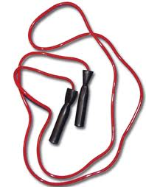
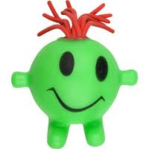
Stimulation
External Stimulation - Eliminate as much as possible
Move to hallway
Use dividers or mats
Limit amount of equipment being used
Self-Stimulation - Eliminate as much as possible
Vigorous exercise
Engagement
Preparation, planning
Allow students to work
for desired reinforcer

Slide 10
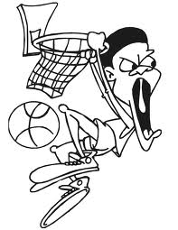
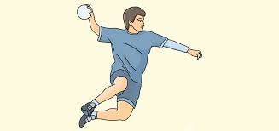
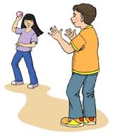
Visuals
If possible, provide a visual - May not understand spoken word, but may be able to associate a visual with activity.
Which is better…
Introducing Basketball: OR
Throw ball with a partner: OR
A
B
A
B

Slide 11
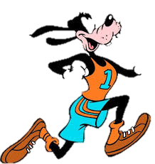
Social Stories
“Describe a situation, skill or concept in terms of relevant “social” cues in a patient and reassuring manner that is easily understood by its audience” (Carol Gray)
Address issues that impact student’s participation in P.E. class,
Tool to assist individuals on spectrum to better understand,
Can be presented in written illustrated form.
“Going to PE” by Lindsey Etzelmiller
(Source: Teachers Pay Teachers)
Alyssa’s Notebook

Slide 12
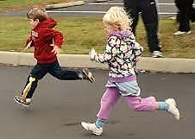
Playing in PE (A Social Story about Good Sportsmanship)
Playing games with other kids in PE can be fun, but I won’t always win.
Sometimes I will win, but sometimes I will lose, and that is OK!
I will tell others “Good game!” or give them a high five and say “Nice job!”
I will smile and have a good time. It’s OK to not win all the time.

Slide 13
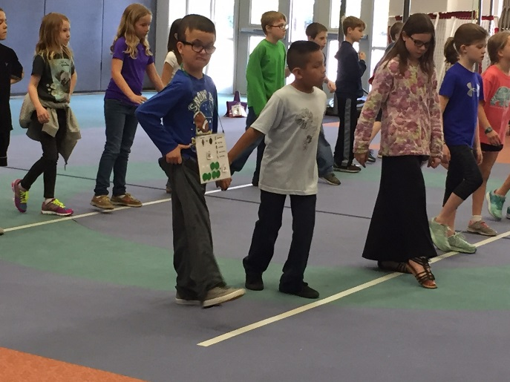
Reinforcement
POSITIVE
SPECIFIC
FREQUENT
CONSISTENT
Verbal Praise
“Great job waiting in line!”
“Thank you for sitting quietly.”
“Awesome job bouncing the basketball!”
“Good try shooting the ball!”
Physical (depending on student)
High fives
Hugs
Pats on the back
Pressure
Token Boards - Earn reinforcer

Slide 14
Forced Choices
Teacher: “Do you want to play soccer?”
Student: “No.”
Teacher: “Do you want to kick the soccer ball?”
Student: “No.”
Teacher: “Do you want to hold the soccer ball?”
Student: “No.”
Instead, use a forced choice - give the student a feeling of control:
“Do you want to play soccer for 5 minutes or 10?”
“Are you going to kick the purple soccer ball or the red?”
“Soccer or math?”

Slide 15
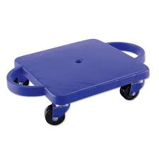
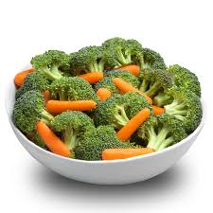
Premack Principle
Follow an undesirable activity with a desirable activity.
First PE...then computer.
Shoot 5 times…then run.
Stretch first…then scooter.
Eat veggies…then ice cream.

Slide 16
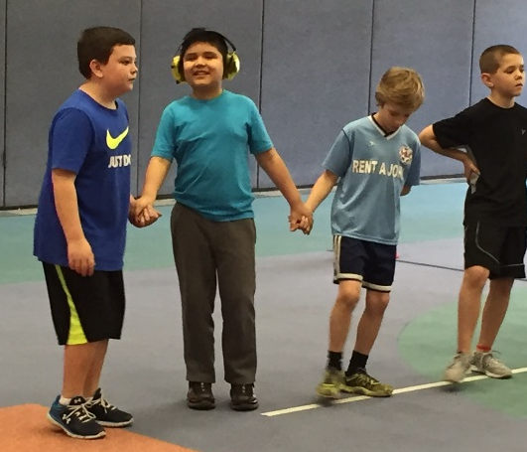
General Tips for Autism
Be enthusiastic!
Have a plan
Know your students
Accept mini victories
Lining up correctly
Waiting for turn
Eye contact
Smiles
Ask questions
Classroom teacher
Paraeducators
Student
Never underestimate

Slide 17
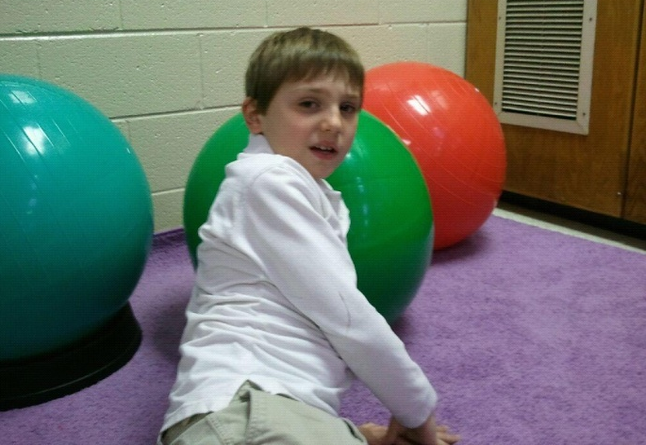
Autism Adaptations Overview
Visuals – station signs, PEC system, picture stories, etc.
Predictable/structured routine
Warm-up, activity, closure
Smooth transitions
Stations
Allow for extra time
Eliminate excessive stimulation
Vigorous exercise – reduce repetitive behaviors
Duplicate classroom teacher’s teaching strategies:
Applied Behavior Analysis
Verbal Behavior Approach
Token System
Reinforcers – touch, sensory toys, water breaks

