Slide 1
Adapted Physical Education 101
Presented by the
NC-APE-Advisory Council

Slide 2
Adapted Physical Education is…
Also known as Specially Designed Physical Education
Special education
Not a related service
Related - PT, OT, Speech
A direct service
Just like math, English, science, social studies, etc.
Required by law for students that demonstrate a need for specially designed instruction.

Slide 3
Adapted vs. Adaptive
Adapted - verb denoting the process of modifying (e.g. they adapted the activity, equipment, or facilities) or an adjective referring to a program or service delivery outcome (e.g. adapted games were used; the program was adapted.
Adaptive - adjective that describes behaviors, skills, or functions.........
Education and service delivery are adapted, behaviors are adaptive.

Slide 4
It’s The Law
The Individuals with Disabilities Education Act (IDEA), Public Law 108-466 (2004), states that physical education is a required service for children and youth between the ages of 3-21 who qualify for special education services because of a specific disability or developmental delay.
Federal Law (PL 94-142, PL 101-476, PL 105-17, PL 108-446) mandates the following in regards to physical education and students with disabilities: General. (1) As used in this part, the term special education means specially designed instruction, at no cost to the parents, to meet the unique needs of a child with a disability, including- (i) Instruction conducted in the classroom, in the home, in hospitals and institutions, and in other settings; and (ii) Instruction in physical education.
(2) The term includes each of the following, if it meets the requirements of paragraph (a)(1) of this section:
Physical education- (i) Means the development of-
(A) Physical and motor fitness;
(B) Fundamental motor skills and patterns; and
(C) Skills in aquatics, dance, and individual and group games and sports (including intramural and lifetime sports); and (ii) Includes special physical education, adapted physical education, movement education, and motor development.
(3) Specially-designed instruction means adapting, as appropriate to the needs of an eligible child under this part, the content, methodology, or delivery of instruction- (i) To address the unique needs of the child that result from the child's disability; and (ii) To ensure access of the child to the general curriculum, so that he or she can meet the educational standards within the jurisdiction of the public agency that apply to all children.

Slide 5
Translation…
Physical education services, specially designed if necessary, must be made available to every child with a disability receiving free appropriate public education (FAPE).
Adapted PE is direct special education required by law, it is not a local option or decision.

Slide 6
Who Can Provide APE?
All teachers licensed in PE.
How prepared are you?
One class in undergrad,
Partner/Buddy to one student,
Controlled environment,
Appropriate equipment,
25 years ago,
Before your knees went bad,
In the snow, uphill, both ways.
Best practice - employ a physical educator with MAEd in APE and/or CAPE certification to plan and implement your APE program.

Slide 7
What’s The Difference?
Modified
GPE with accommodations or modifications (e.g. changing rules, equipment, time limits)
Adapted
Instruction in PE designed on an individual basis to meet specific needs of a child with a disability.
versus
The GREY Area – You’re the specialist!

Slide 8
Determining Eligibility for APE
If a child with a disability cannot access the general PE curriculum and/or participate safely and successfully during PE, individualized instruction designed to meet the unique needs of the student, must be provided.
Whether a student receives APE is an IEP team decision, driven by data.
The IEP team should include someone with firsthand knowledge about the student’s abilities and needs for participating in and learning the Healthful Living/PE Essential Standard.
Guess who???

Slide 9
Yep…that’s you.

Slide 10
Guiding Questions for Eligibility
Can the student independently participate in GPE with non-disabled peers?
Can GPE instruction be differentiated so the student can participate?
Provide written instructions in advance
Deliberate small group assignment
Modify tasks or skills
What are the student’s strengths? Needs?
Is GPE the student’s least restrictive environment (LRE)?
In order for the student to access the GPE curriculum, does instruction need to be designed just for him/her?
Can the student access the GPE curriculum safely and successfully without specialized instruction?

Slide 11
Determining Eligibility for APE
IEP Team meets
Team determines the need for APE evaluation = data, data, data
Evaluation completed
Student qualifies for APE
Now what???

Slide 12
Next Steps…
IEP Goodies
Check “Yes” to:
“Does the student require APE?” or
“Does the student require specially designed physical education?”
Develop APE Components of IEP:
Must have input from someone knowledgeable
about the PE curriculum.
Present Level of Academic Achievement and Functional Performance (PLAAFP)
Goals/Objectives
Means of reporting student progress
Frequency/Service delivery
Determination of LRE

Slide 13
LRE and the APE Continuum
“What is the best educational scenario for
THIS student?”
LRE Factors (in no particular order):
Student’s disability/level of need
Scheduling
Support Services
Age Appropriateness
Assessments
EC Teacher
GPE Teacher
LRE varies from school to school, student to student.
Regular education students have a right to learn too.

Slide 14
Continuum of Possibilities
Level 1
General Physical Education (GPE)
Level 2
GPE with APE Consultation
Level 3
APE Direct Services in GPE
Self-Contained APE with additional staff
Level 4
Self-Contained APE
Level 5
Students with and without disabilities participate in PE,
no assistance
Accommodations and modifications identified, and implemented by GPE.
GPE teaches class, APE teacher provides direct service to student(s) during GPE.
GPE or APE teaches
students with special needs in small group setting.
GPE, APE, PT, OT, Paraeducators, Volunteers, etc.

Slide 15
Evaluations
There are over 40 evaluation tools that can be used to determine eligibility for APE services.
Which tool is appropriate?
“Well…it depends.”
Examples can be found on the North Carolina Adapted Physical Education Advisory Council website:
www.nc-ape.com/resources

Slide 16
No APE Specialist?
Update knowledge of disabilities and teaching strategies related to teaching students with special needs.
Collaborate with other service providers
EC Teacher
PT, OT, SLP
Parents
Administration
Paraeducators
Explore and use resources:
NC-APE-AC
Colleges and universities
Recreation programs for special populations
Sports programs for special populations

Slide 17
Cheat Sheet
All Exceptional Children (EC) students must receive, minimally, the same amount of PE as regular education students, per federal regulations. | If an IEP team suspects that a student may require APE, an APE evaluation must be completed by an APE specialist.
General Physical Educators are Adapted Physical Educators. In the occurrence that an APE specialist does not serve a student directly, the GPE becomes the direct service provider. | Students with physical disabilities are not the sole recipients of APE. APE is provided to all students that require specially designed instruction (e.g., students with autism, BIPs, etc.)
Not all students who are recommended for APE need a separate (self-contained) PE class. | Adapted physical education is considered a direct instructional service and not a related service.
No student may be exempt from PE due to his/her disability. | The need for adapted physical education is an IEP team decision.
GPE should be invited to IEP meetings, and considered a part of the IEP team for any and all EC students they teach. | If providing direct service to EC students, the GPE should be aware of IEP goals, health concerns, and necessary modifications. Consultation and collaboration between GPE and APE is important.
Within the IEP, APE goals and objectives are developed through collaboration between APE, EC teacher, and GPE. | NC-Adapted PE-Advisory Council www.NC-APE.com

Slide 18
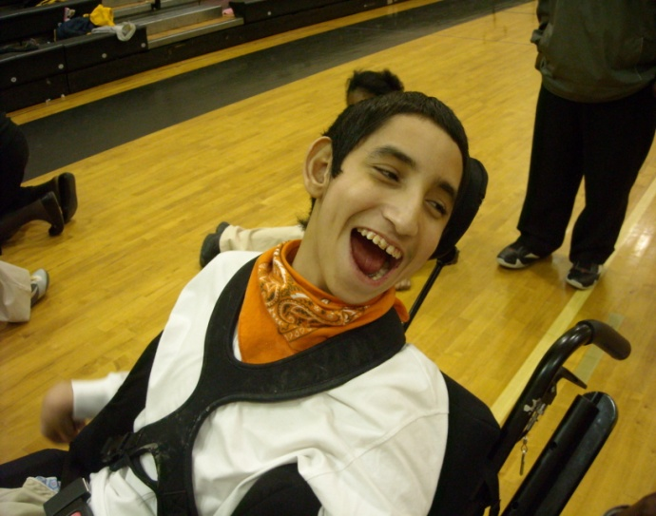
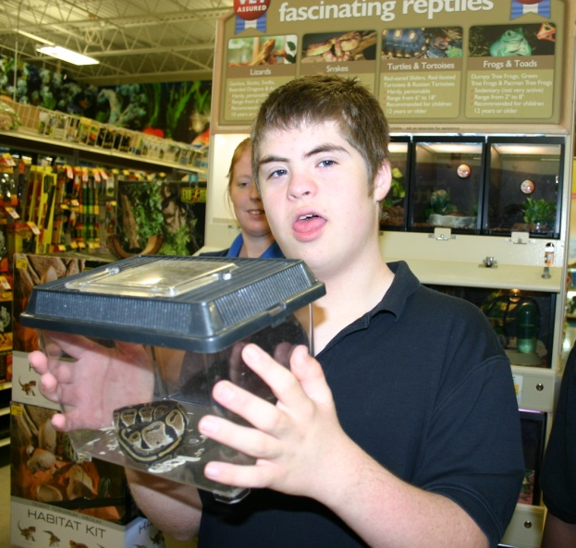
Adaptations by Disability
Cerebral Palsy
Use balloons or beach balls
Modify rules or games
End activity before student gets frustrated
Enlarge targets
Use extension for tag games (Foam Noodle)
Use large scooters, create “boat” on scooters
Focus on reaching, grasping, pushing
Use slower locomotor patterns for regular education students.
Bear crawl, crab walk, hopping, etc.
Down Syndrome
Positive, positive, positive
Avoid stress to neck area
Highly structured environment
Brief instruction
Visual instruction - demonstrations
Set-up for success
Be consistent with motivation

Slide 19
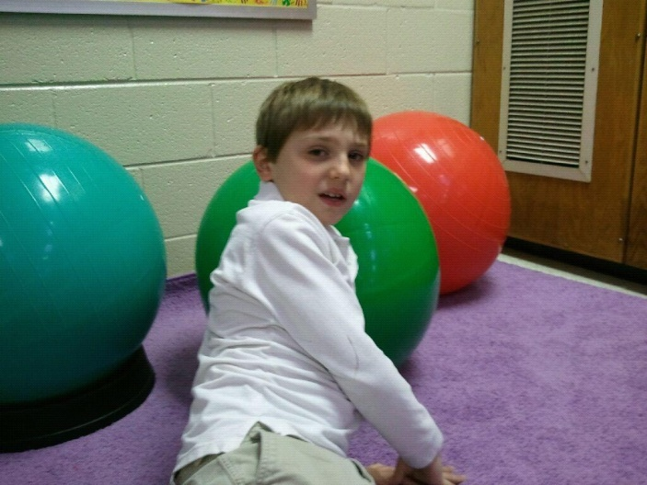
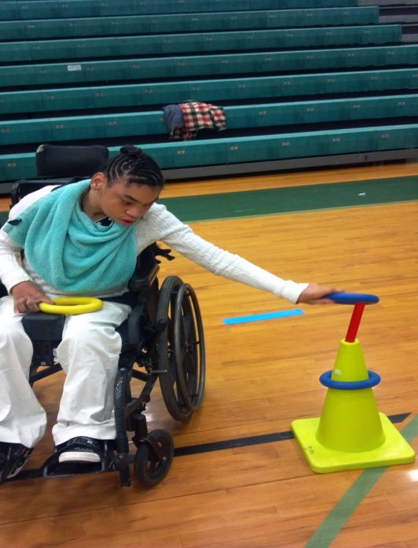
Adaptations by Disability
Autism
Visuals – station signs, picture stories, etc
Predictable/structured routine
Warm-up, activity, closure
Smooth transitions
Stations
Allow for extra time
Eliminate excessive stimulation
Vigorous exercise – reduce stimming
Duplicate teaching strategies of teacher
Applied Behavior Analysis
Verbal Behavior Approach
Token System
Reinforcers – touch, food, candy
Wheelchairs
Ask the student!
Get them out of their chairs
Safety first
Stationary, slower moving balls
Vary distances
Use longer, lighter equipment
Lower goals
Use slower locomotor patterns
Bear crawl, crab walk, hopping, etc.

Slide 20
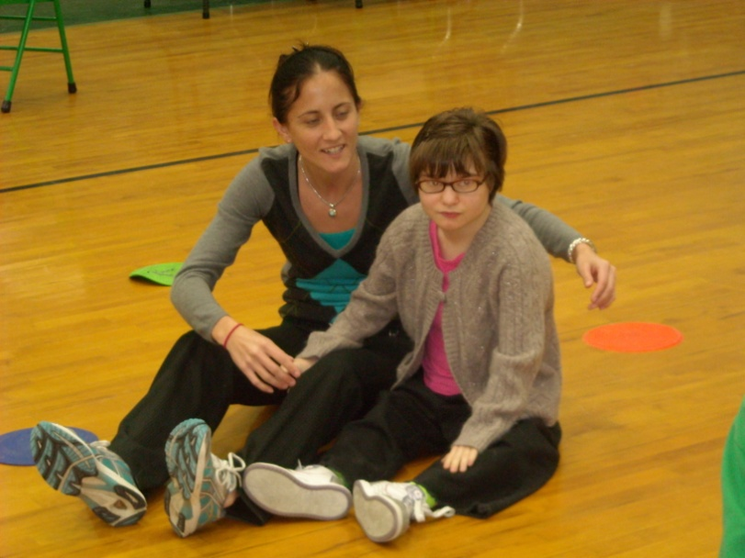
Adaptations by Disability
Visual Impairments
Safety first
Keep it clean
Avoid overprotecting
Notify of changes made to gym
Give physical assistance (only if necessary)
Increase size of equipment
Use brightly colored equipment
Use beep balls, bell balls
Give physical assistance
Use guides
Wall
Guide wire
Carpet runner
Hearing Impairments
Determine start/stop signal
Use visual demonstrations
Stand still when giving directions
Make sure student can see your lips
Learn basic signs
Be aware of any balance issues

Slide 21
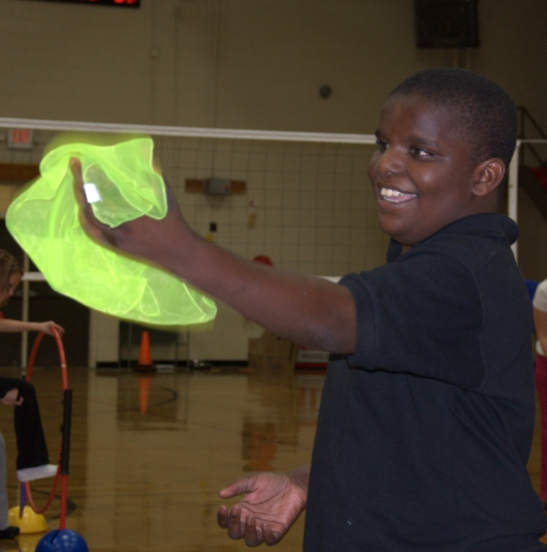
Adaptations by Disability
Multiple Disabilities
Be patient
Be flexible
Use brightly colored equipment
Use visuals for boundaries
Poly spots, cones, rope
Break tasks into smaller steps
Modify equipment
Use physical and verbal prompting
Provide immediate feedback
Self paced activities
Stations
Task cards
Give lots of positive reinforcement and praise
Verbal and physical

Slide 22
Modifications by Limitation
Limited Strength | Limited Speed
Shorten distance to move or propel object Use lighter equipment Use shorter and lighter striking implements Allow students to sit or lie down while playing Allow students to monitor their own fatigue Use deflated balls or suspended balls Change movement requirements | Shorten distance or change distances for different students Change locomotor pattern Equalize competition among teams Make safe areas in tag games
Limited Coordination and Accuracy | Limited Balance
Use stationary objects for kicking/striking Decrease distance for throwing, kicking, and striking Make targets and goals larger Use scarves, balloons, bubbles to enhance visual tracking skills Increase surface of striking implements Use larger balls for kicking and striking Use softer, slower balls for striking and catching Use lighter, less stable pins in bowling-type games. | Provide chair, bar or buddy for support Teach balance techniques (widen base, use arms) Increase width of surfaces to be walked Use carpeted areas rather than slick surfaces Teach student how to fall Place student near wall for support Lower center of gravity

Slide 23
Modifications by Sport
Badminton | Basketball | Bowling | Floor Hockey
use oversized racquets use larger birdies use a lower net allow students to sit eliminate the net use a balloon instead of a birdie | use smaller, lighter ball use a different type of ball (e.g., playground ball) use a lower goal use a goal with a larger circumference modify rules use smaller playing area | use lighter ball use fewer number of pins allow students to push ball while sitting use ramp allow three tries instead of two use empty milk jugs as pins create lanes with cones | use oversized sticks use lighter sticks use larger ball or puck increase size of the goal use smaller playing area modify rules do not use goalies
Kickball | Soccer | Softball | Volleyball
use a lighter, larger ball allow students to use a hockey stick to contact ball (wheelchairs) decrease distance to base use one base allow student to kick ball when stationary | use lighter, larger ball allow students to use a hockey stick instead of kicking the ball use smaller playing area allow students to play with a buddy allow student to walk to ball or roll wheelchair to ball use larger goal | use a lighter, larger ball use a lighter bat use shorter distance around bases use one base allow more than three strikes use batting tee allow more time to get to bases | use a beach ball or balloon allow students to sit on the floor lower net use no net at all smaller playing court allow ball to bounce once before hitting allow unlimited number of hits allow more than one try when serving

Slide 24
Paraeducators Also known as: Teacher Assistants, Paraprofessionals, Instructional Assistants
Main Focus – to assist teacher(s) in implementing a student’s IEP.
Can provide valuable information regarding student’s:
Behaviors at certain times during the day
Communication skills
Likes and dislikes
Medical issues
Other ideas for adaptations/modifications
Tips for Working With Paraeducators
Be aware of expectations set in place by classroom teacher.
Start off on a good note! Make them like you. ☺
Empower them.
If para is not doing what is asked of them, always go to the classroom teacher.
If possible, give them specific instructions.
Keep a log.
Issues with paraeducators are county/school/classroom based.
Make it fun for them!

Slide 25
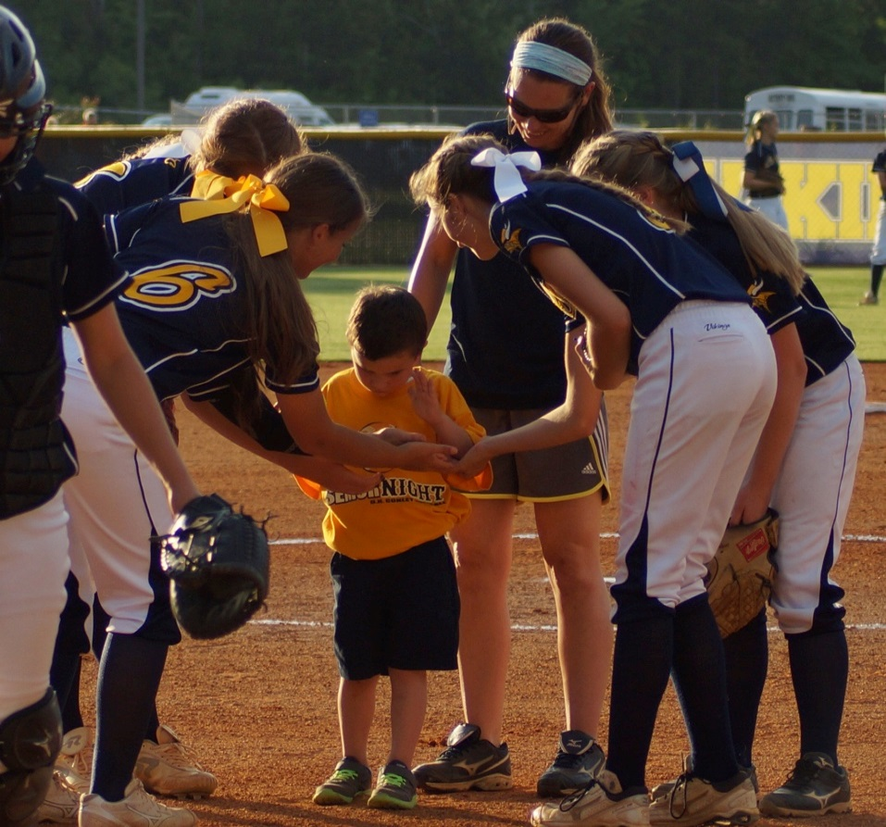
Tips
Be Enthusiastic!
Educate Yourself
Workshops
Professional literature
Webinars
Professional organizations
Observe in the Classroom
Teaching strategies
Behavior techniques
Reinforcers
Build Relationships
Students
Paraeducators
Teachers
Plan Ahead
All parties will benefit
Embrace Change
Adapt curriculum
Paradigm shift
Appreciate Mini-Victories
Lining up correctly
Eye contact
Waiting their turn
Smiles
Ask Questions
Focus on what they CAN do!
Adapt the game to the student, NOT the student to the game.

Slide 26
Questions?
Contact us directly through email and/or phone! Contact information can be found here…
www.NC-APE.com

